Slide 1
IRRIGATION WATER QUALITY & BASIC SALINITY MANAGEMENT
R.R. Duncan PhD.
Professor (Retired) University of Georgia
RDuncan EcoConsulting, LLC.
Email: rduncan4612@gmail.com
Cell: 1-830-431-0204

Slide 2
Turfgrass-Soil-Atmospheric-Man “EcoSystem”
ADD SALINITY
TO THE ECOSYSTEM
Turfgrass Plant

Slide 3
SALINITY IMPACT ON A TURFGRASS ECOSYSTEM
From irrigation water: salt ion foliar adsorption: Na, Cl, Mg, S
Salt compound (HCO3, CO3, SO4) accumulation in the soil profile
Loss of turf root hairs & total root volume➔reduced cytokinin production
Disruption in soil availability of critical nutrients: deficiency symptoms in canopy
Soil CEC sites competition between salts (Na, Mg) & nutrients (K)
Increased soil borne disease problems

Slide 4
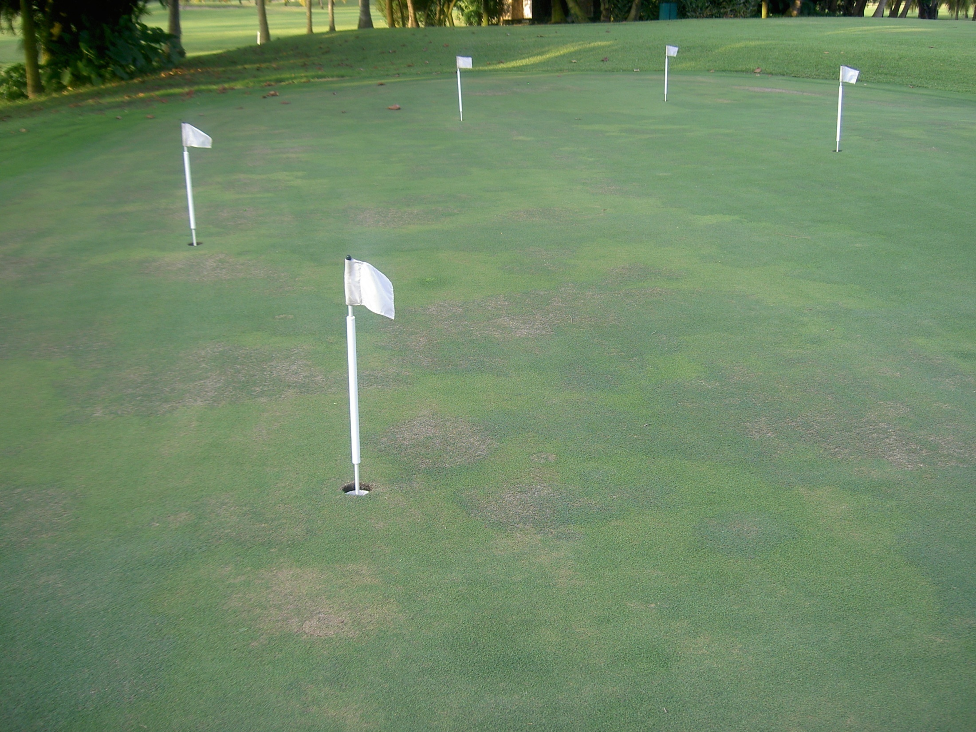
SALINE SOIL STRESS

Slide 5
SOLUBLE SALT TYPES
IN IRRIGATION WATER
Salt ions & compounds---Na+, Ca++, Mg++, K+, B+++,SO4-, NO3-, Cl-, HCO3-, CO3-2
Soluble salts---KCl, Na2SO4, K2SO4, CaCl2, NaCO3, MgCO3, others
Less soluble salts---CaSO4, CaCO3, CaHCO3, others (all root adsorbed) (Dolomite, calcium sulfate anhydrite)
Note: irrigation water must contain at least 20 ppm or 1 meq/l calcium for proper soil surface infiltration & percolation

Slide 6
Salts In Irrigation Water
Cations F.P.*
Calcium (Ca⁺⁺) 43
Magnesium (Mg⁺⁺) 27
Sodium (Na⁺) 1
Potassium (K⁺) 1.7
Anions
Carbonates (CO₃⁻⁻)
Bicarbonates (HCO₃⁻)
Chlorides (Cl⁻)
Sulfates (SO₄⁻)
Nitrates (NO₃⁻)
*F.P.=Flocculating power in the soil
Ca⁺⁺ Mg⁺⁺ Na⁺
Relative Ion Size and Water Films

Slide 7
SALT MOBILITY IN THE SOIL
HIGHLY MOBILE: Cl, SO4, K
INTERMEDIATE MOBILITY: Mg
LEAST MOBILE: Na, CO3, HCO3

Slide 8
THRESHOLD CRITICAL SALINITY COMPONENTS IN IRRIGATION WATER
Sodium 125 ppm 5.43 meq/L
Bicarbonates 120 ppm ~2.00 meq/L
Chlorides >355 ppm >10.0 meq/L
Sulfates 180 ppm 1.36 meq/L
TDS >1000 (BG) ->1500 ppm (SP)
Calcium >20 ppm >1.0 meq/L
AT ANY POINT IN TIME: THE BEST SOIL SALINITY IMPACT WILL BE YOUR INCOMING IRRIGATION WATER QUALITY COMPOSITION/CONCENTRATION UNLESS YOU HAVE FREQUENT RAINFALL FOR DILUTION.

Slide 9
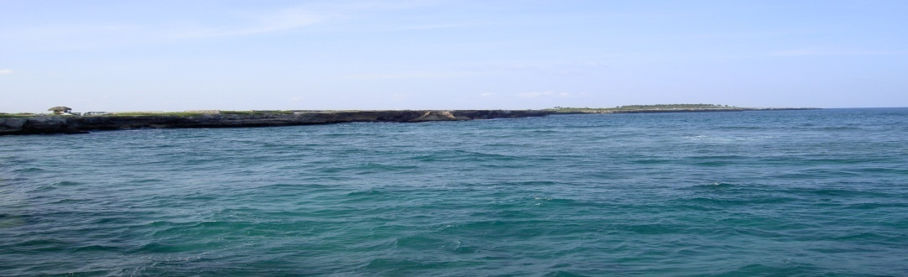
IRRIGATION WATER SUITABILITY
IMPACT ON TURF GROWTH
Acceptable Potential Problem Problem
ECw dS/m 0-0.75 0.75-3.00 >3.00
TDS ppm 0-480 480-1950 >1950
IMPACT ON SOIL STRUCTURE/ LAYERING
adjSAR meq/L 0-6.0 6.0-10.0 >10.0
ECw dS/m >0.50 <0.51
Bicarbonates
ppm 0-122 123-525 >525
meq/L 0-2.0 2.0-8.61 >8.61
Carbonates
ppm 0-12 13-62 >62
meq/L 0-0.4 0.43-2.07 >2.07
IMPACT ON ROOTS
Acceptable Potential Problem Problem
Sodium
meq/L 0-2.9 3.0-5.4 3 >5.43
ppm 0-68 69-125 >125
Chloride
ppm 0-140 141-360 >360
Boron ppm 0-05 0.06-2.0 >2.0
IMPACT ON FOLIAGE
Sodium ppm 0-70 71-125 >125
Chloride ppm 0-100 101-305 >305
NOTE: ABOVE RANGES ARE FOR BERMUDA AND BENTGRASS; PASPALUM TOLERATES MUCH HIGHER CONCENTRATIONS

Slide 10
IRRIGATION WATER SALT
CONCENTRATION
Potable
Ocean Water

Slide 11
SODIUM LOADING FROM WATER
PPM | MEQ/L | LBS/ACRE-INCH(27,154 gal) | LBS/ACRE-FOOT (325,851 gal)
23 | 1.0 | 5.22 | 62.64
69 | 3.0 | 15.65 | 187.80
125 (turfgrass) | 5.43 (threshold) | 28.35 | 340.20
300 | 13.04 | 68.04 | 816.48
10,600 (ocean water) | 460.87 | 2404.12 | 28,849.44
REQUIRES 20 LBS CALCIUM TO OFFSET 23 LBS OF SODIUM; OTHERWISE, SODIUM WILL ACCUMULATE IN THE SOIL TO BREAK DOWN SOIL STRUCTURE & DISRUPT NUTRITIONAL BALANCES; ADDITIONALLY, SOLUBLE SODIUM IN IRRIGATION WATER WILL FOLIARLY FEED DIRECTLY INTO TURFGRASS SHOOTS.

Slide 12
Salinity Challenges
Soluble salts are mobile and dynamic.
Spatial variations in accumulated soil salts are dispersed horizontally across the landscape, vertically within the soil profile, and temporally. Temporal changes may be due to wet/dry seasons or events/changes in irrigation water quality.
Salinity problems are site-specific.
Salinity problems are on-going 365 days/year and 24/7
Salinity is often THE DOMINANT STRESS ---If it is not controlled, all other management practices are less effective & cannot compensate for salt accumulation in the soil in the plant & the subsequent multiple environmental stresses.

Slide 13
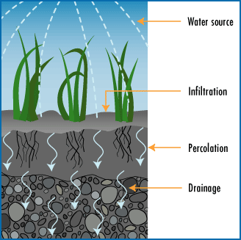
ON DAYS WITH HIGH ET &
NO RAINFALL, TOTAL
SALINITY IN WATER CAN BE
2-5x HIGHER ON SURFACE
Salt migration layer
Salt accumulation zone
AERATION + LEACHING

Slide 14
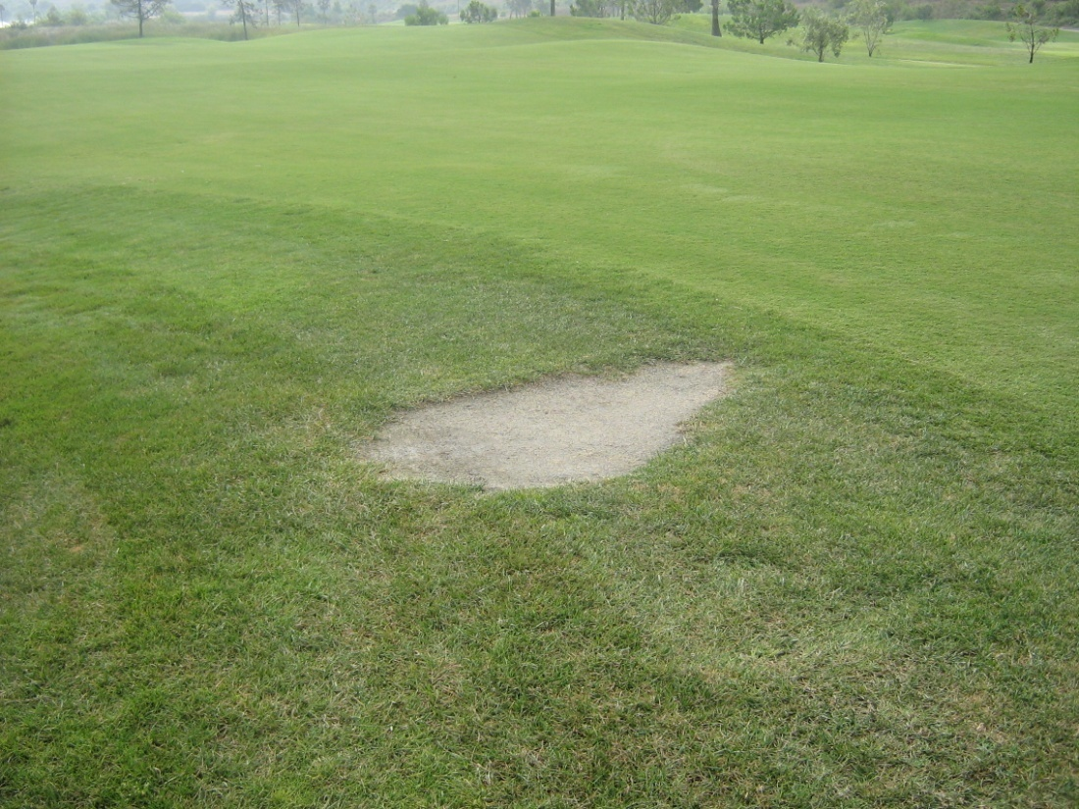
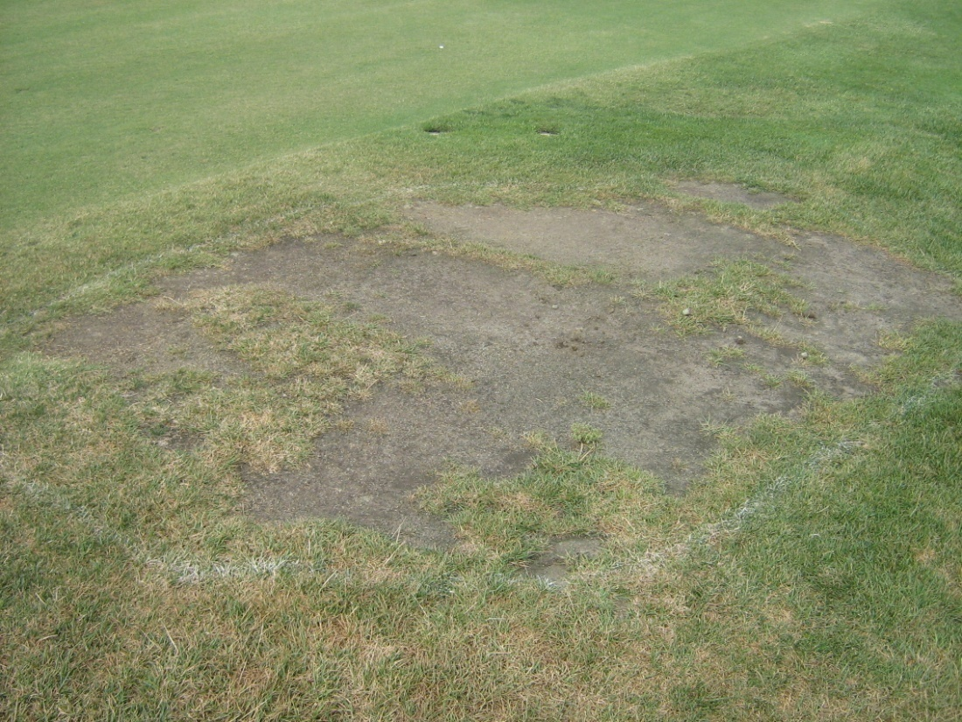
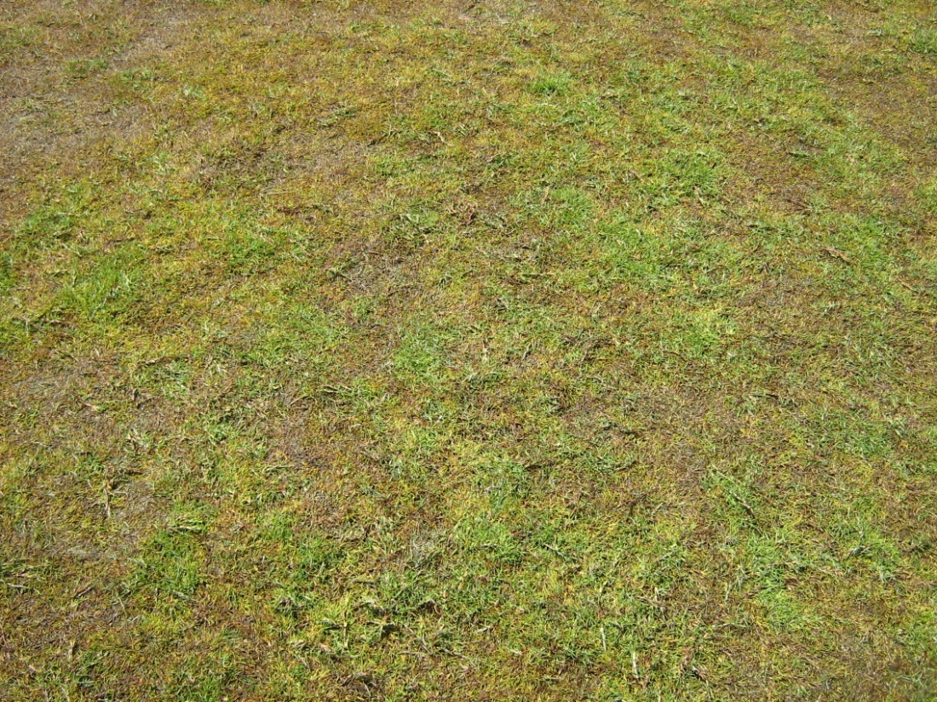
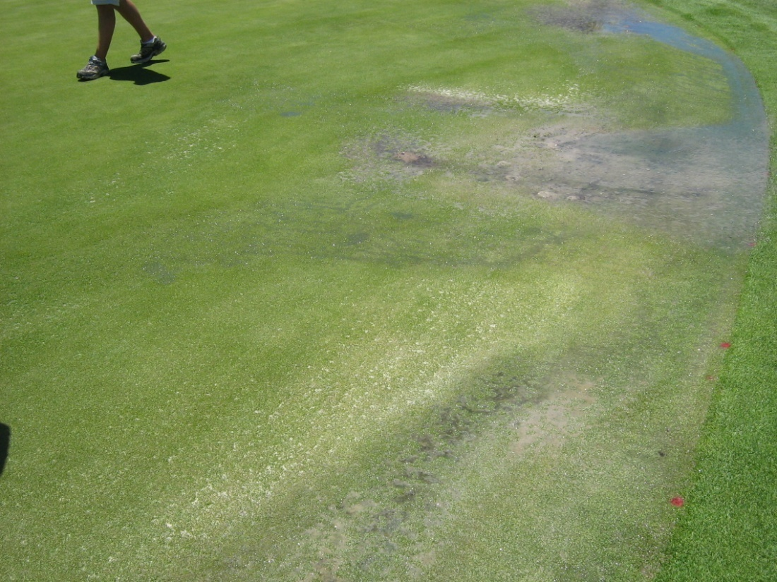
Salt Scald Areas

Slide 15
AGUA PARA RIEGO
ALCALINIDAD pH 9.71
CONDUCTIVIDAD ELECTRICA 17.08 mmhos/cm=dS/m (TDS=11,956 ppm)
CATIONES Calcio (Ca**) 7.0 meq/l 140.9 mg/l=ppm
Magnesio (Mg**) 17.0 meq/l 206.6 mg/l
Sodio (Na*) 157.0 meq/l 3611.0 mg/l
Potasio (K*) 0.7 meq/l 27.4 mg/l
ANIONES Cloruros (Cl-) 135.4 meq/l 4808.3 mg/l
Carbonatos (CO3-) 7.5 meq/l 224.3 mg/l
Bicarbonatos (CO3H-) 23.4 meq/l 1425.2 mg/l
Sulfatos (SO4-) 19.6 meq/l 940.0 mg/l
RAS 45.3

Slide 16
AGUA DE CANCHA AZUL
pH 7.2
Bicarbonatos 8.67 meq/l 528.7 mg/l
Cloruros 1.61 meq/l 56.9 mg/l
Sulfatos 0.95 meq/l 45.7 mg/l
Calcio 3.87 meq/l 77.4 mg/l
Magnesio 2.42 meq/l 29.5 mg/l
Potasio 0.28 meq/l 10.9 mg/l
Sodio 5.46 meq/l 125.6 mg/l
RAS 3.1

Slide 17
AGUA DE LAGUNA 1 TRENQUE LAUQUEN
pH 7.56
Calcio 2.38 meq/l 47.50 mg/l
Magnesio 9.26 meq/l 113.oo mg/l
Carbonatos 0.40 meq/l 12.oo mg/l
Bicarbonatos 10.46 meq/l 638.00 mg/l
Sodio 68.00 meq/l 1564.00 mg/l
RAS 28

Slide 18
BASICS OF SALT-AFFECTED SOILS
Sustainability challenges: Levels of total soluble salts and/or exchangeable Na are high enough to adversely affect turf quality & performance and/or soil structure
Soil Classifications
**SALINE: high total (dissolved) soluble salts=TDS
**SODIC: high exchangeable Na accumulation
**SALINE-SODIC: both high total soluble salts and high exchangeable Na accumulation in the soil & plant
Soil salt loading differs with type of clays(expanding/ contracting or non-expanding) and with sand quality (specific sand sizes <0.25 mm in size or fines including silt + clay fractions) + inorganic and organic sand substitutes in greens profiles must be considered in management decisions

Slide 19
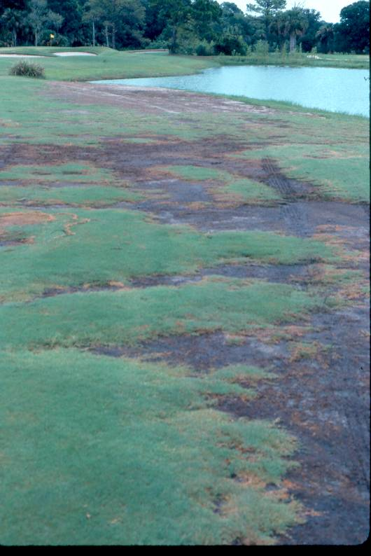
SODIC SOIL SALINITY

Slide 20
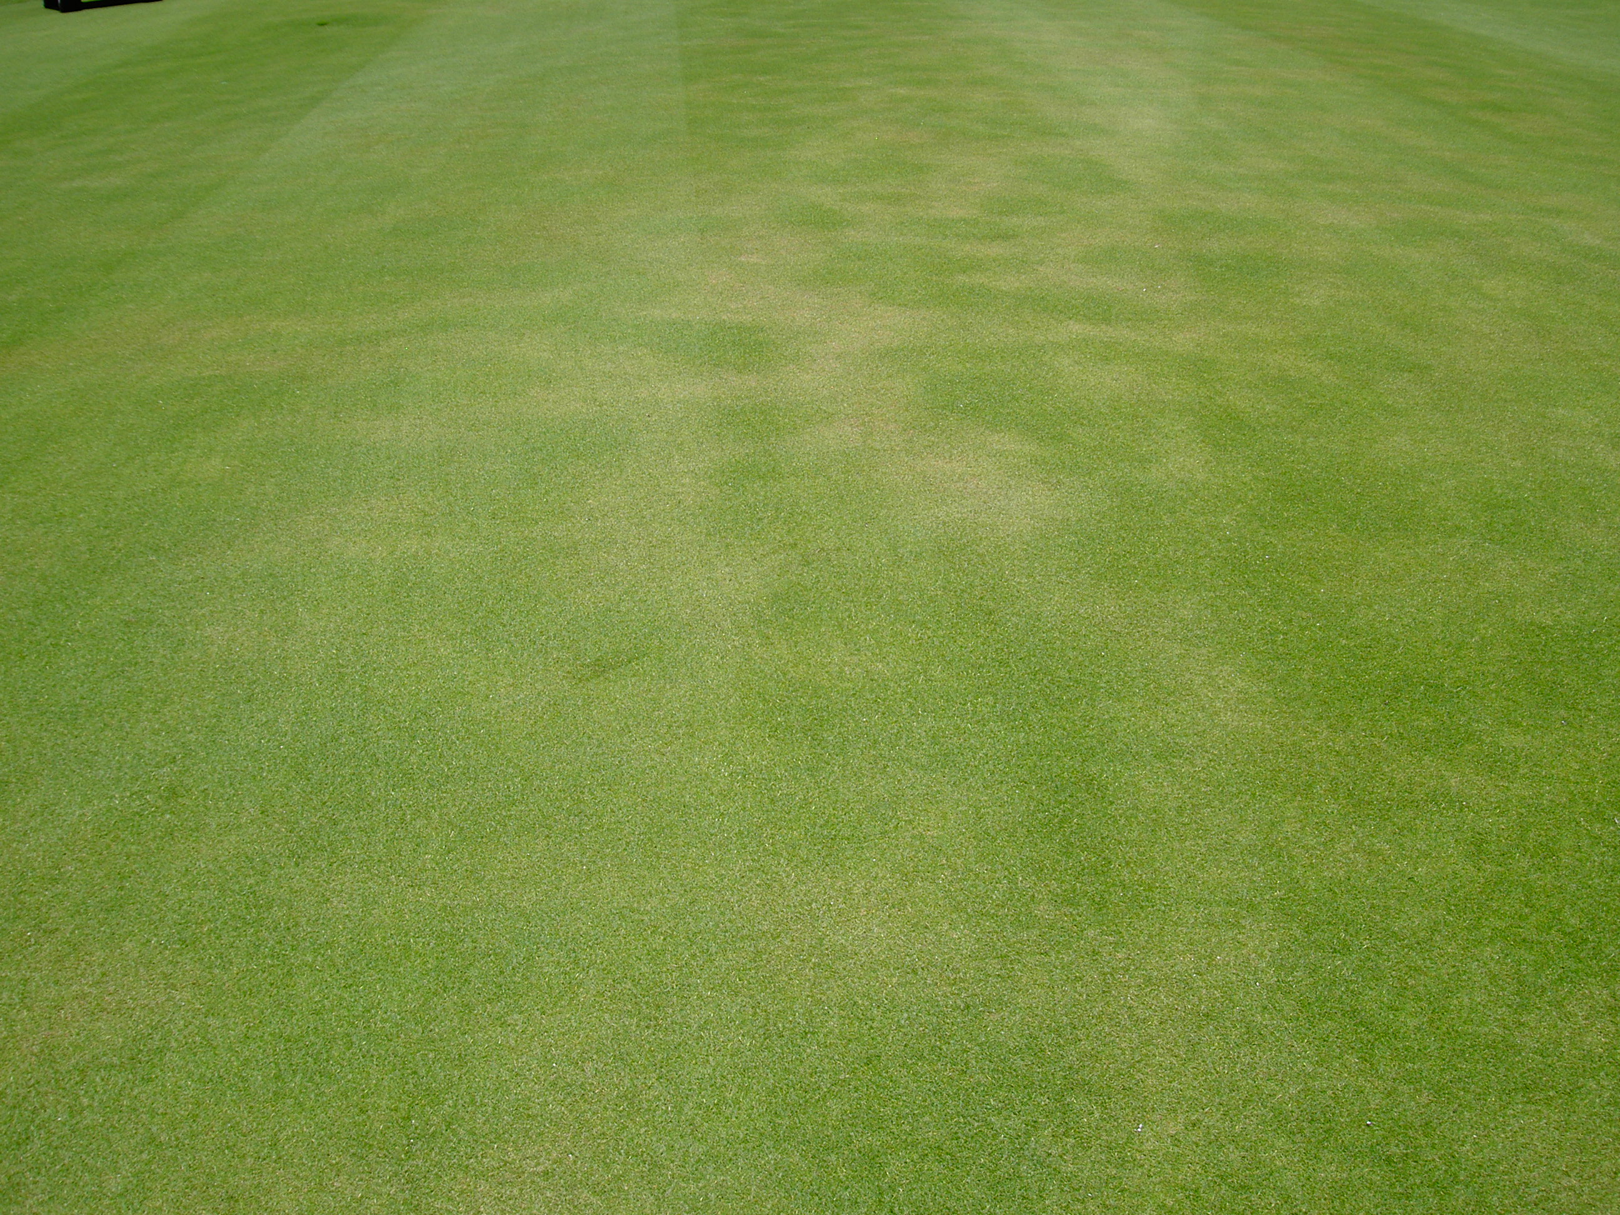
SALINE SOILS
INCREASED INCIDENCE OF LOCALIZED DRY SPOT

Slide 21
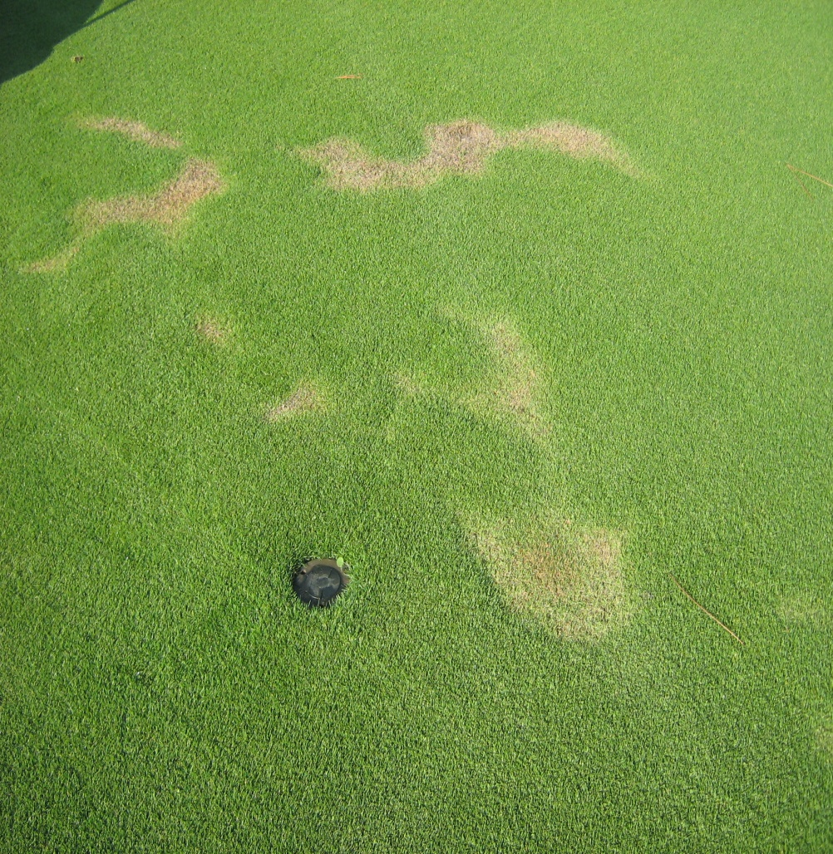
IRRIGATION WATER QUALITY SURFACE
TENSION (OSMOTIC) PROBLEMS
ECw TDS kPa
0.78 500 28
1.56 1000 56
3.13 2000 113
4.69 3000 169
6.25 4000 225
7.81 5000 281
9.38 6000 338
10.94 7000 394
11.72 7500 422
INCREASED LOCALIZED
DRY SPOTS & DROUGHT STRESS CHALLENGES

Slide 22
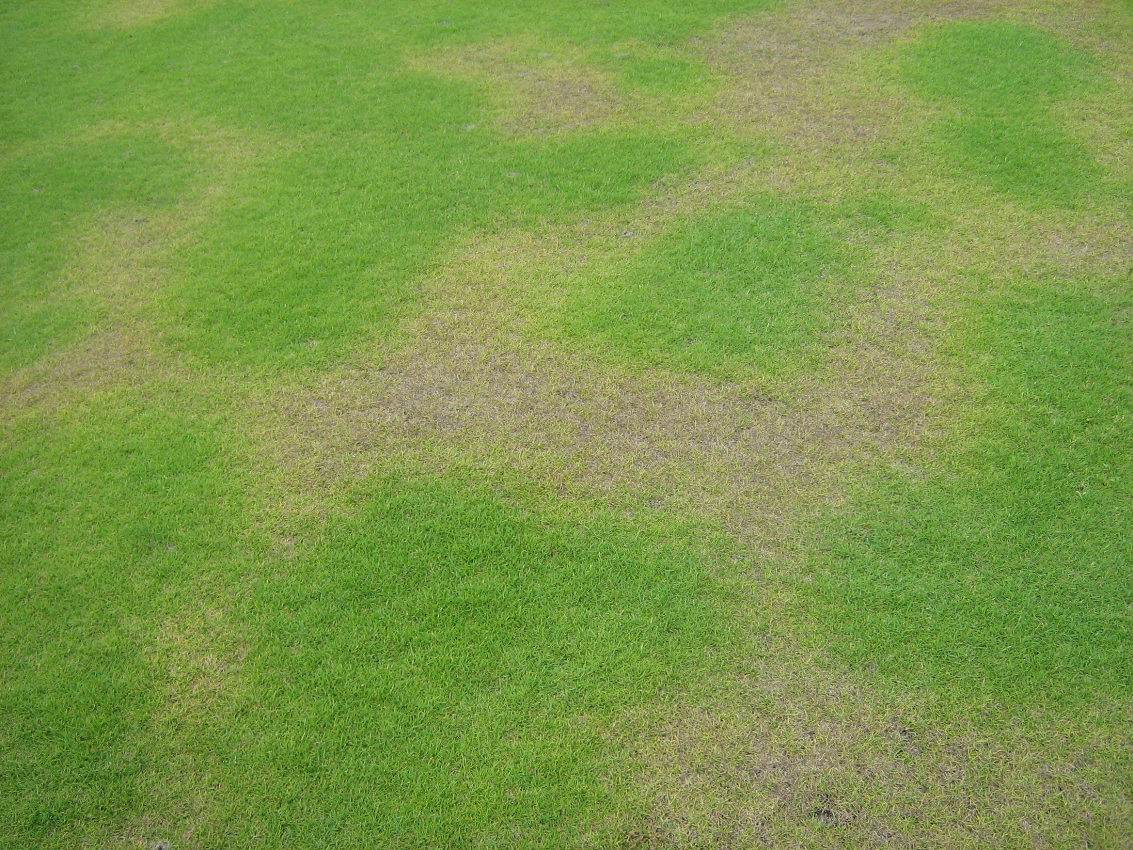
SALINE SALINITY SYMPTOMS

Slide 23
Reasons to Fertilize with Salinity Challenges
Basic nutrition
Correct imbalances (foliar/root uptake, soil available, actual plant uptake, cultivar requirements)
Correct leaching losses in soils
Activate plant stress tolerance mechanisms (salinity, wear/traffic, drought, high temperature, winter hardiness)
Adjust soil chemical problems (pH, sodic, acid sulfate, acid injection)
Regulate plant growth rates

Slide 24
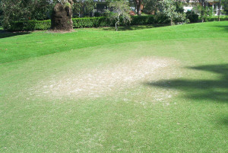
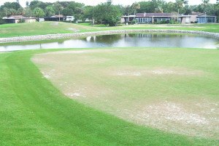
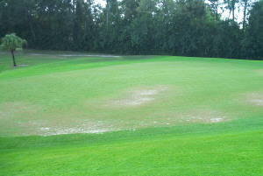
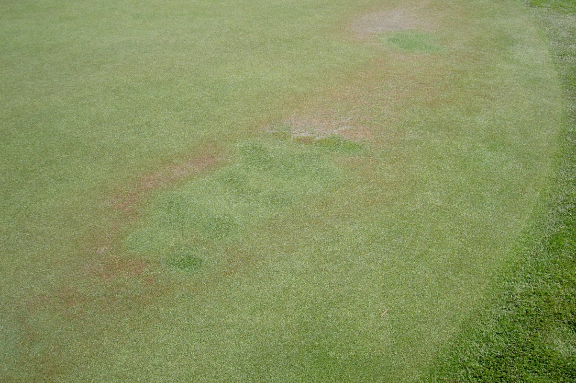
RE-SOD PROBLEM AREA

Slide 25
Mobility of nutrients
internally in the
turfgrass plant
Mobile: N, P, K, Mg, Cl, Na
Somewhat mobile: S, Cu, Mo, Zn, B
Salt Mobility in Soil:
Mobile—Cl, SO4, K Intermediate-- Mg
Least—Na, CO3, HCO3

Slide 26
Calcium product release
Fast Release/Solubility (foliar application for foliar uptake) **Calcium nitrate **Calcium chloride
**Calcium acetate **Calcium gluconate/glucoheptonate **Ca complexed with sugar alcohols or amino acids
Intermediate Release/Solubility ( only root uptake) **Calcium sulfate (gypsum)
**Calcium thiosulfate
Slow Release/Solubility (liquid/granular application; only root uptake) **Calcium hydroxide or oxide **Calcium carbonate (lime) **Phospho-gypsum **Dolomite
**Calcium silicate
**Calcium sulfate anhydrite
Extremely slow release/very low solubility
**Powdered coral

Slide 27
REMOVING EXCESS SODIUM
ACCUMULATED IN THE SOIL
Granular lime or gypsum SOIL additions
Reaction: Extra AVAILABLE Ca displaces Na on the cation exchange sites
Acidification (acid injection or sulfur generator or acid forming fertilizers)—Reaction: provides free sulfates & reduces bicarbonates (maximum ~50%), freeing up previously complexed elements (Ca, Mg, P, Na); releases available Ca to counter excess Na
Displaced Na binds with the sulfates or carbonates
Sodium sulfate & sodium carbonate/bicarbonate compounds are leachable compounds with good irrigation management & adequate infiltration/ percolation rates down through the soil profile
Caution when acidifying calcareous sands or with heavy thatch layer in native soils!!

Slide 28
FERTILIZER SALT INDICES
Potassium chloride 116
Ammonium nitrate 105
Sodium nitrate 100
Urea 75
Potassium nitrate 74
Ammonium sulfate 69
Ammonia 47
Potassium sulfate 46
Potassium magnesium sulfate 43
Diammonium phosphate 34
Monoammonium phosphate 30
Ordinary superphosphate 8
Monopotassium phosphate 8
Gypsum 8
Limestone 5
Natural organic (5% N) 3.5
Dolomite 1

Slide 29
ACIDIFYING FERTILIZERS
Calcium carbonate equivalent per 100 lbs
Calcium carbonate equivalent per 100 lbs
Pure sulfur 313
Anhydrous ammonia 148
Sulfur coated urea 119
Ammonium sulfate 110
Polymer/sulfur coated urea 105
Urea 84
Polymer coated urea 80
Ureaform 68
Diammonium phosphate 64
Ammonium nitrate 59
IBDU 57
Monoammonium phosphate 56
Activated sewage sludge 10
Relative basicity products
Dolomite 109
Limestone 100
Sodium nitrate 29
Potassium nitrate 26
Calcium nitrate 20

Slide 30
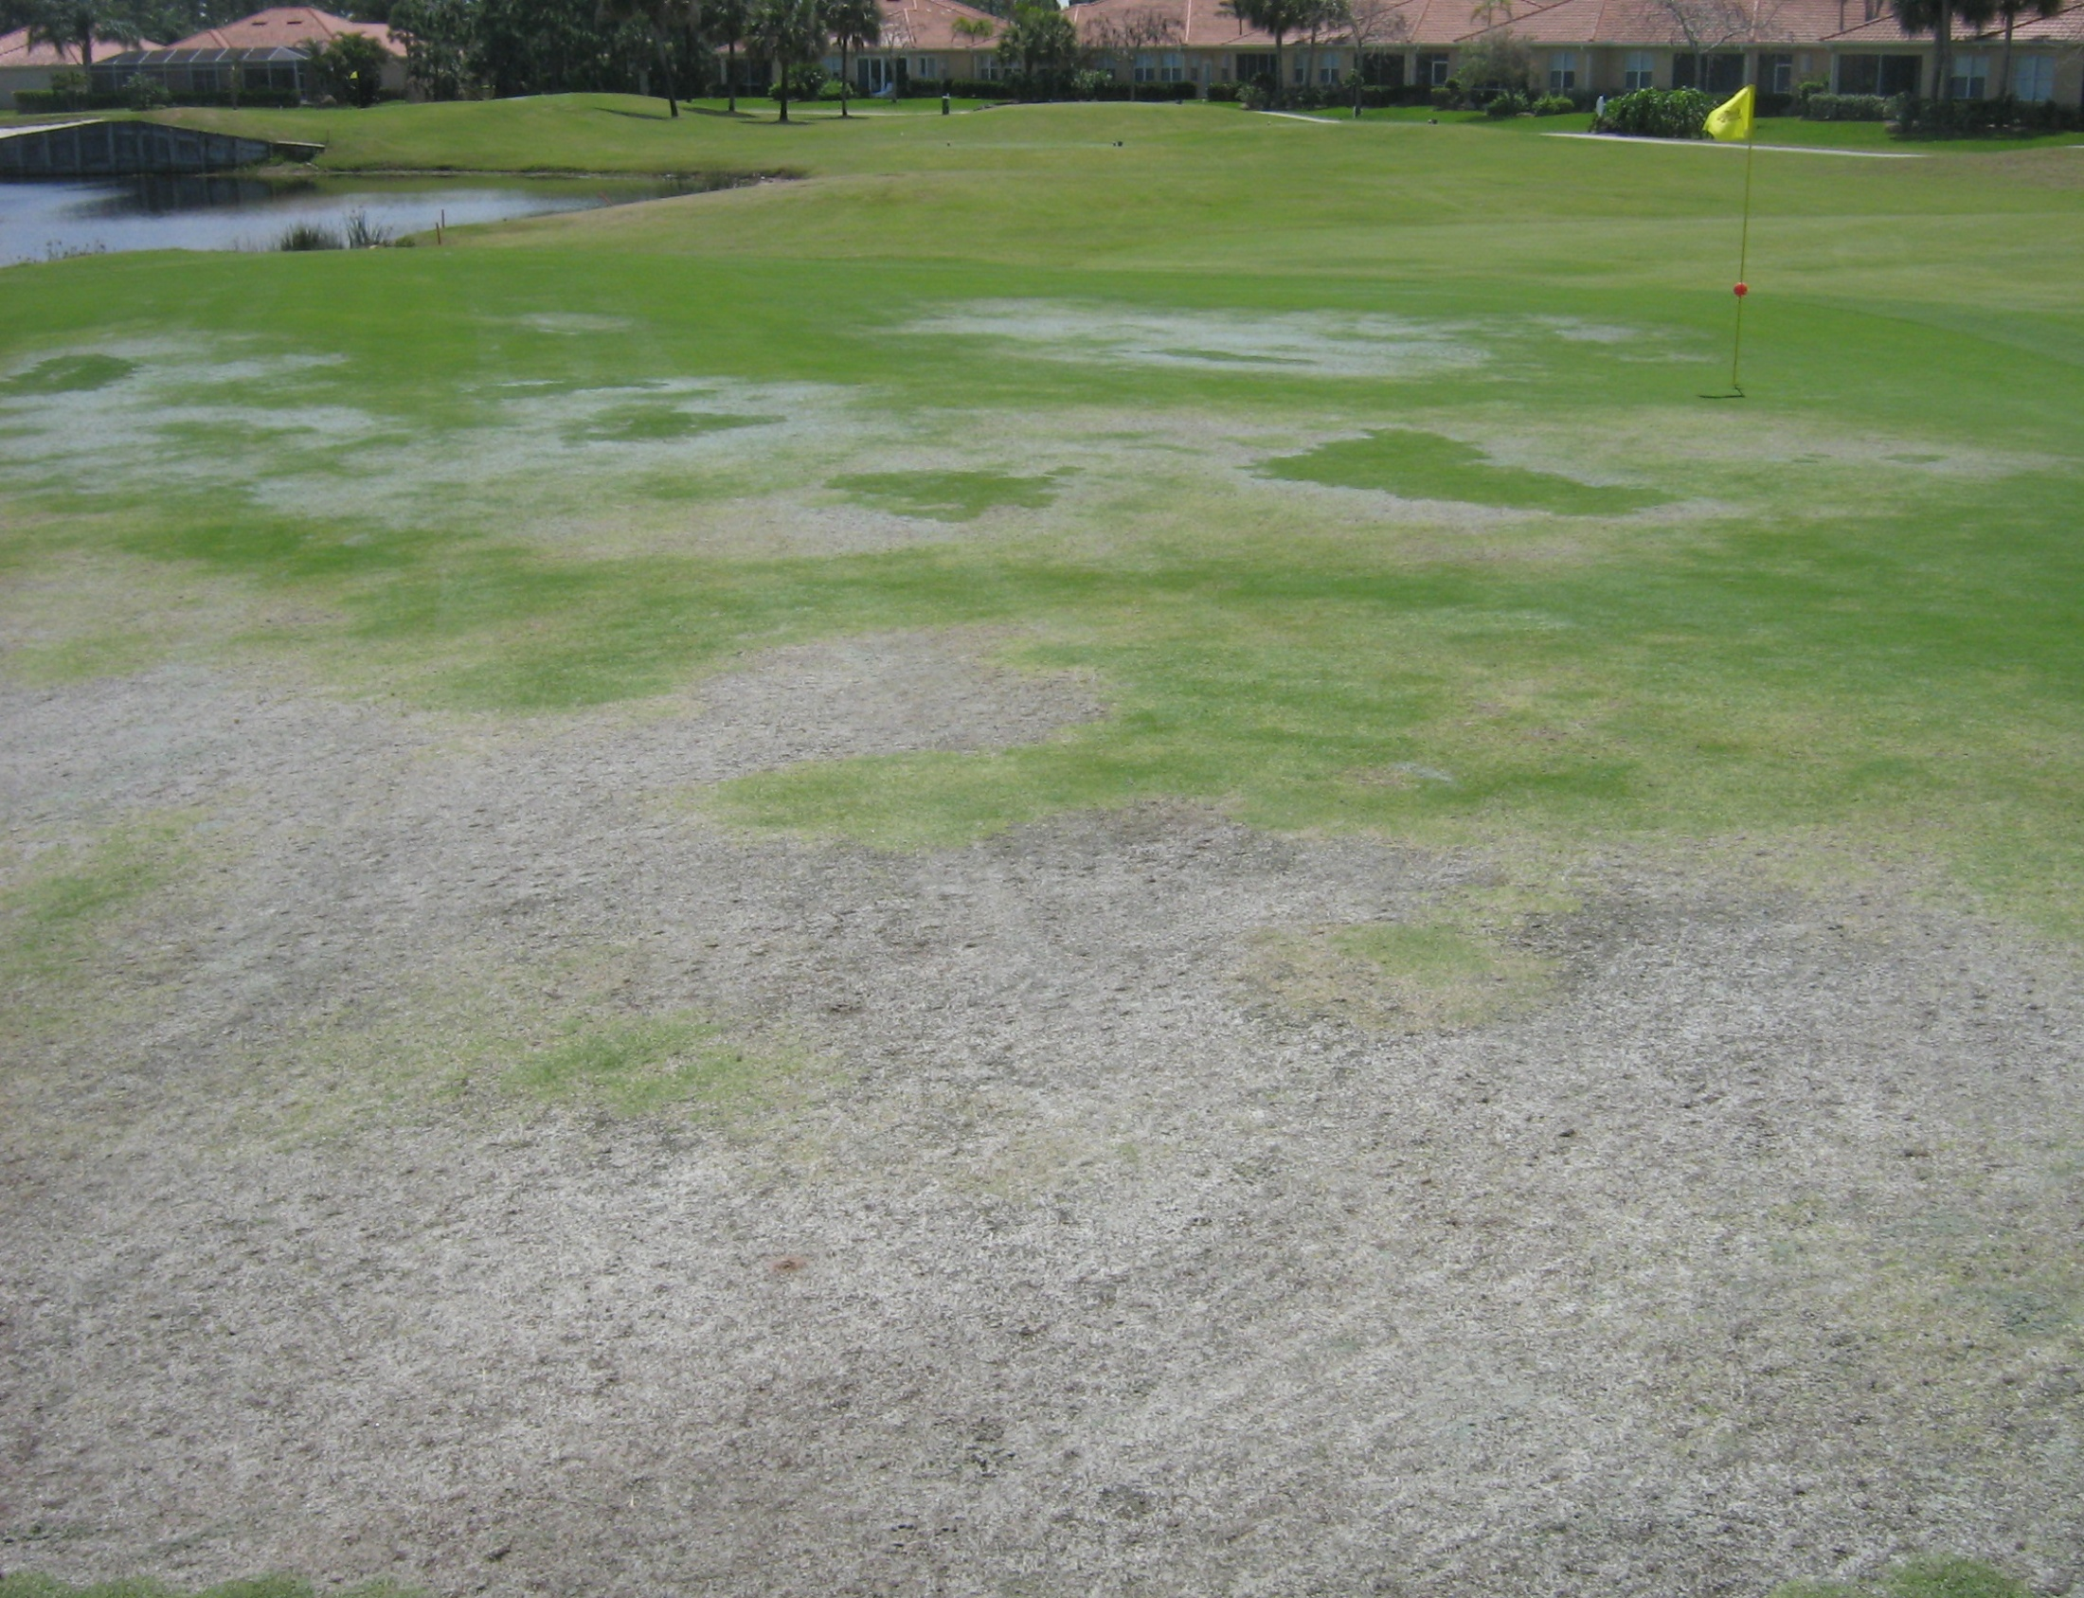
MUST FIX THE SOIL INFRASTRUCTURE PROBLEM BEFORE REPLANTING
SALINITY IS A WHOLE-ECOSYSTEMS ISSUE

Slide 31
