Slide 1
MANAGEMENT TIPS FOR SEEDED PASPALUM GREENS
R.R. Duncan, PhD.
Professor (Retired) University of Georgia
RDuncan EcoConsulting, LLC.
Email: rduncan4612@gmail.com
Cell: 1-830-431-0204

Slide 2
PURE DYNASTY SEEDED PASPALUM
Planting recommendations
Nutritional maintenance recommendations
Herbicides (www.platinumte.com)
Pre- & post-control of Poa without overseeding
Paspalum control on Tifeagle bermudgrass greens & surrounds
Basic management practices for championship playing surfaces (topdressing, growth regulators, equipment)
PURE DYNASTY HAS BEEN PLANTED IN 53 COUNTRIES, ON 70 GOLF COURSES, AND 15 SPORTS FIELDS

Slide 3
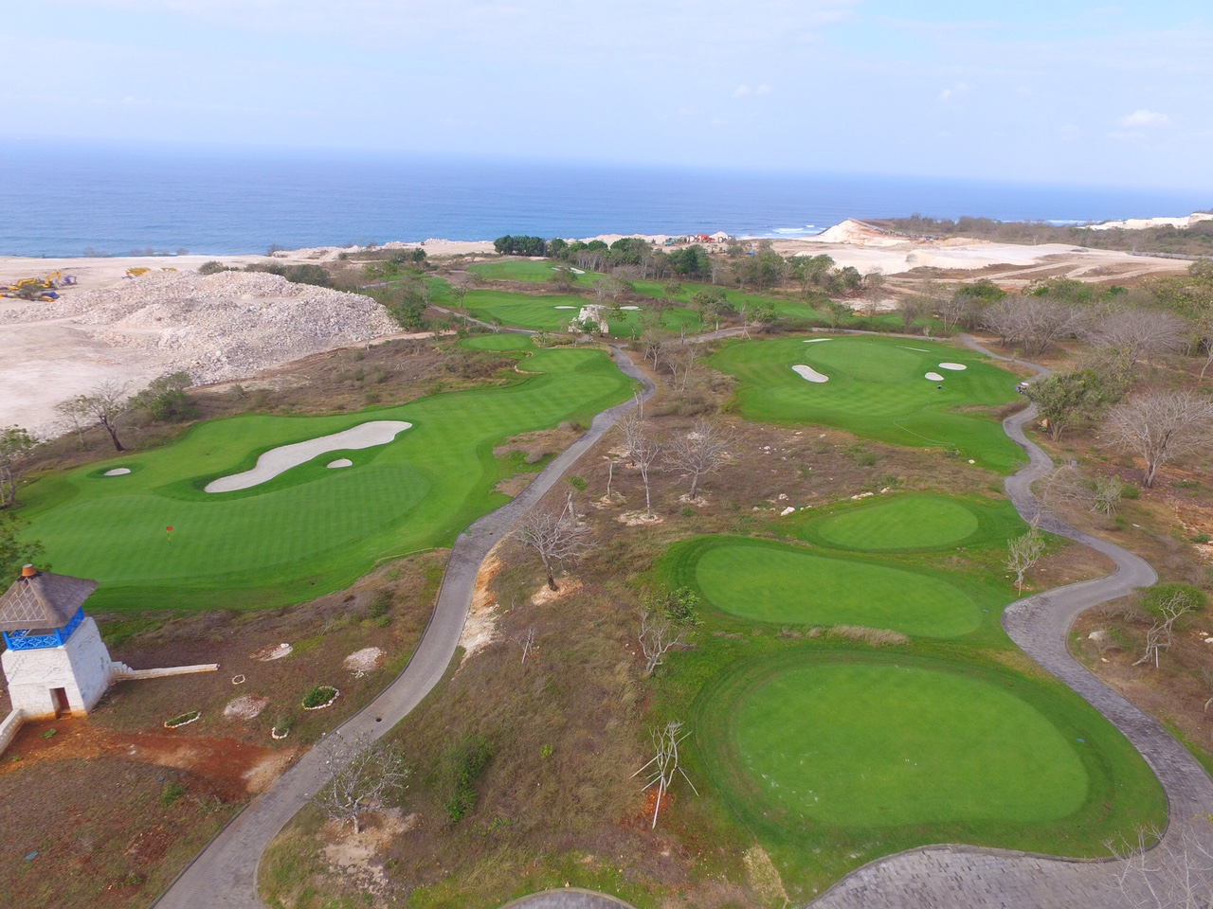

Slide 4
TURF SITE INFRASTRUCTURE CONSIDERATIONS
*Native soil rhizosphere profiles: organic matter concentration, CEC at least 2.5-3.5 meq/100 g. for paspalum
*Removal of previous grass species on the greens & surrounds: herbicide applications or removing 75 mm of the upper soil profile on the bermudagrass greens
*Remediate any soil salinity accumulation issues pre-plant***
*Irrigation water quality (salinity impact): <1000 ppm TDS (higher TDS?)
*Planting method: slit-seeding or hydro-mulching or broadcast

Slide 5
SEED PLANTING & EARLY ESTABLISHMENT
*745,000 seed per pound or about 44 lbs/acre
*Germinating early seedlings do not have high salinity tolerance mechanisms activated for ~1-2 weeks
*Pre-plant applications of gypsum (calcium sulfate) or lime (calcium carbonate—acid soils) to supply available calcium
*Pre-plant applications of potassium & phosphorus for root development
*Pre-plant application of granular manganese and zinc to activate the salt tolerance mechanisms in the emerging seedling root system

Slide 6
GREENS ESTABLISHMENT & GROW-IN
*Root & rhizome development generally takes 3+ weeks. Genetic priority is root development.
*Low requirement for nitrogen for about the first month of establishment; prescription N applications (calcium and potassium nitrates) can provide N sufficiency requirements of the grass during grow-in. ***PASPALUM ONLY ABSORBS NITRATES.***
*When surface stolons have accomplished about 75-80% canopy coverage, light verticutting in different directions will be needed to stimulate full canopy density development
*Paspalum is a luxury user of both sulfates and magnesium

Slide 7
PASPALUM AND HORMONES & PGRs
Seashore paspalum management requires an understanding of hormonal requirements=>highly hormonally regulated grass.
An extensive root volume normally means that natural cytokinins are being produced. When sufficient cytokinins are available in the roots, the cytokinins translocate up to the shoots to balance gibberellins and auxins needed to develop canopy density.
With germinating seeds and development of the root system, foliar application of additional cytokinins (seaweed/kelp products can escalate development of canopy density and recovery from stress challenges during establishment.

Slide 8
GROW-IN TO FULL CANOPY DENSITY—PLANT GROWTH REGULATORS
Avoid gibberellin inhibitors like trinexapac-ethyl (Primo) that slow down or stop increases in canopy density
Seed head suppression: paclobutrazol,, ethephon, fluprimidol
*Aneuw (prohexadione calcium) has proven to be effective on growth suppression on bunker faces, surrounds, fairways, & roughs
To enhance & escalate establishment/recovery from stress damage:
Kelp extract/cytokinin phytohormone products: help to balance GA and auxins in the shoots=>canopy density
*Paspalum responds rapidly to local palm tree fertilizers & hormones

Slide 9
FERTILITY CONSIDERATIONS
Pre-plant:
Normally, a good balanced NPK granular. Understand that very little of the nitrogen will be adsorbed during post-germination and early establishment due to irrigation leaching & low N requirement.
The two most critical nutrients for any paspalum: available calcium and potassium at all times.
Seasonal Nitrogen requirements will generally be less than half of bermudagrass. Paspalum will adsorb nitrate nitrogen & store the N for later use.

Slide 10
FERTILITY CONSIDERATIONS
Maximum color expression: Ca, Mg, Fe, Mn, S,P,K
Salinity stress tolerance activation: Ca + K (in shoots); Mn + Zn (in roots); cytokinins (hormonal balances in whole plant)
Drought stress tolerance activation: Molybdenum (nutritional): Silicon (protectant); salicyclic acid (hormonal). Note: paspalum does not go drought dormancy like bermudagrass or zoysiagrass.
For greens speeds: silicates, potassium, calcium (excess N will slow down ball roll)
Periodic application of micronutrient packages is recommended.

Slide 11
PASPALUM TISSUE NUTRIENT SUFFICIENCY CONCENTRATIONS
*2.00-2.50% N *50-500 ppm Fe (mainly in waxes)
(Target: <3.5%N)
*0.30-0.60% P *20-250 ppm Zn
*2.00-4.00% K *50-300 ppm Mn
(Maintain: 3.o-3.5%K)
*0.20-1.50% Ca *5-50 ppm Cu
*0.20-0.60% Mg *5-60 ppm B
*0.20-0.60% S * 150 ppm Al (high on acid soils)
[counter to high Al: calcium]

Slide 12
FERTILITY BMPs
*Calcium + potassium in the cells help to move other key nutrients internally into the cells for photosynthesis and growth activity
*Potassium activates over 80 enzymes for growth and stress recovery
*Root adsorbed manganese activates over 35 enzymes for salinity tolerance activation and root re-development. Manganese can suppress soil borne pathogens in the rhizosphere.
*Sodium will lodge in the wax layer on shoots & stolons while root adsorption of Na is minimized by genetic regulation
*Both iron and aluminum will bind with the wax layer on shoots and stolons & only minimal concentrations will enter the plant tissue.

Slide 13
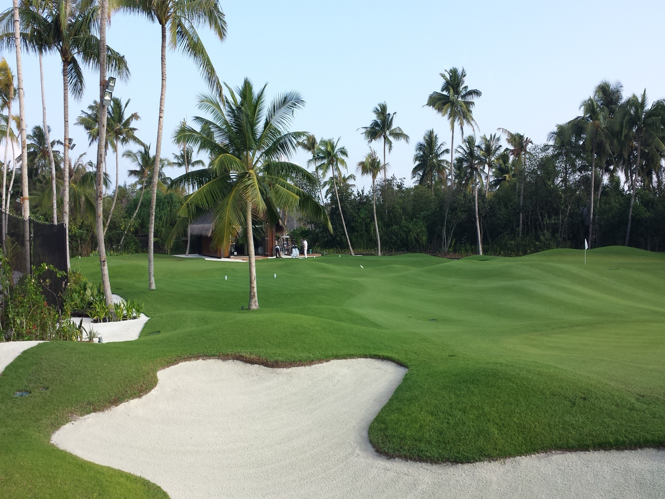

Slide 14
HERBICIDES
Poa annua Annual bluegrass
Pre: dithiopyr, dimethenamid, pethoxamid, indaziflam, oxadiazon (granular only), ethofumesate
Post: flazasulfuron, sulfosulfuron, imazaquin, amicarbazone, methiozolin
NOTE: RATES AND TIMING OF APPLICATION CAN BE FOUND ON www.platinumte.com WEBSITE.

Slide 15
HERBICIDES
CRABGRASS
Pre: dithiopyr, indaziflam, dimethenamid, penthoxamid, oxadiazon (granular only)
Post: quinclorac (<1-2 tiller stage), dithiopyr (seedling)
GOOSEGRASS
Post: sulfentrazone, topramezone (causes bleaching)
RATES & TIMING OF APPLICATION: www.platinumte.com

Slide 16
HERBICIDES
SEDGES AND KYLLING
Pre: halosulfuron, imazaquin, flazasulfuron, sulfosulfuron, pyrimesulfan, bentazon, sulfentrazone + prodiamine, dimethenamid
Post: sulfentrazone, sulfentrazone + carfentrazone
TROPICAL SIGNALGRASS
Pre: pendimethalin, prodiamine, prodiamine + sulfentrazone, dithiopyr, indaziflam, granular oxadiazon (emergence from seed)
Post: dithiopyr, indaziflam (late Spring); amicarbazone, sulfentrazone;
amicarbazone + topramezone (spot treatment)
RATES & TIMING OF APPLICATION: www.platinumte.com

Slide 17
HERBICIDES
BERMUDAGRASS CROSS CONTAMINATION IN PASPALUM
Ethofumesate + flurprimidol (more effective during Spring)
Glyphosate or fluazifop-P-butyl + surfactant(spot treatment)
HERBICIDES WITH SEVERE INJURY POTENTIAL ON SEASHORE PASPALUM:
MSMA, triclopyr, diclofop, fenoxaprop, fluazifop, sethoxydim, atrazine, simazine, metribuzin, foramsulfuron, trifloxysulfuron, ***[pinoxaden—>can be applied to remove paspalum in bermudagrass].***
Combination products: thiencarbazone-methyl + foransulfuron + halosulfuron-methyl; dicamba + iodosulfuron-methyl- sodium + thiencarbazone-methyl

Slide 18
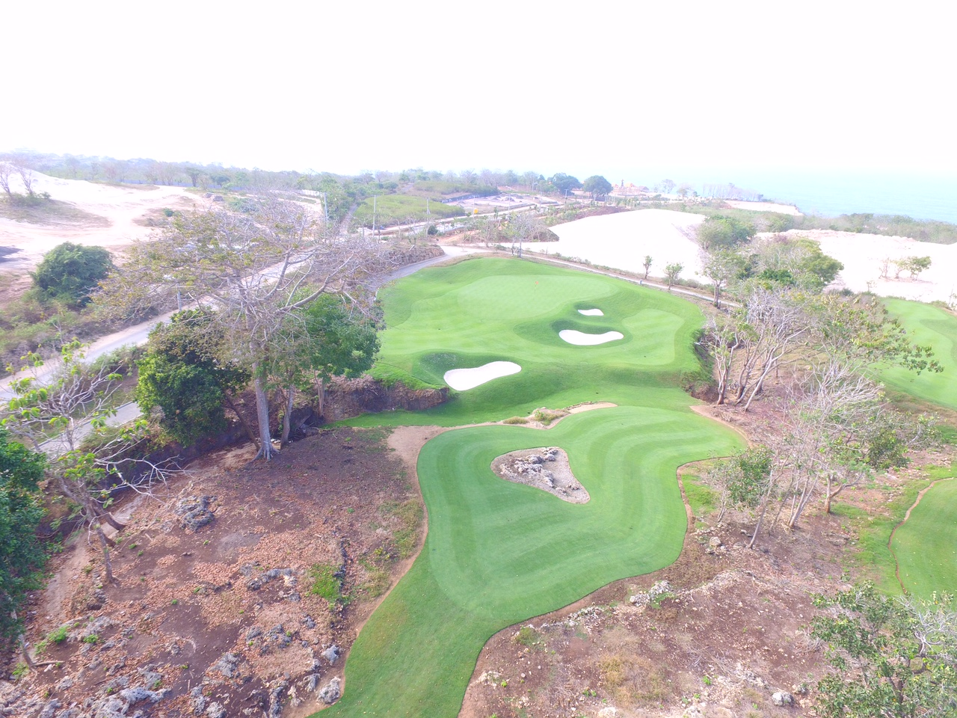

Slide 19
BMPs FOR GREENS PERFORMANCE
Equipment:
Rollers on mowers(solid or paspalum Weihle; but not bermudagrass Weihle rollers=> too aggressive. Causes bruising.)
Brushes in front of solid rollers to ensure leaf blade tips remain horizontally positioned for mowing
Groomers: light, moderate, deeper depth. Removes broader leaves with heavy wax load, which causes ball roll friction plus shortens internode lengths on stolons=>tighter canopy density

Slide 20
BMPs FOR GREENS PERFORMANCE
MOWING PRACTICES
Mower blade sharpness is critical every day (wax load on shoots and stolons will cause dull blades)
Single cut vs. double cut?
Absolutely do not scalp paspalum, especially on greens
Greens mower vs. triplex mower
Determine height-of-cut appropriate to your location, golfer preferences, and canopy surface requirements

Slide 21
BMPs FOR GREENS PERFORMANCE
VERTICUTTING
Cutting the top of surface stolons to reduce ball ‘chatter’ or bumpiness and improved ball roll
Allows sand topdressing to integrate into surface:grass upper zone to improve ball speed. Impact 20% of the greens surface with aeration and sand topdressing each year=>surface firmness & trueness of ball roll
Do not cut rhizomes when verticutting if possible
ROLLING=>2-3 times weekly depending on greens speed

Slide 22
BMPs FOR GREENS PERFORMANCE
*Seashore paspalum does not remove salts from the soil
*The grass TOLERATES SALINITY, but salts in your irrigation water will accumulate over time in the native soil profile
*Aeration, aeration, aeration—have a scheduled management program
*Leaching salts and functional drainage are critical for successful long term greens management and putting quality

Slide 23
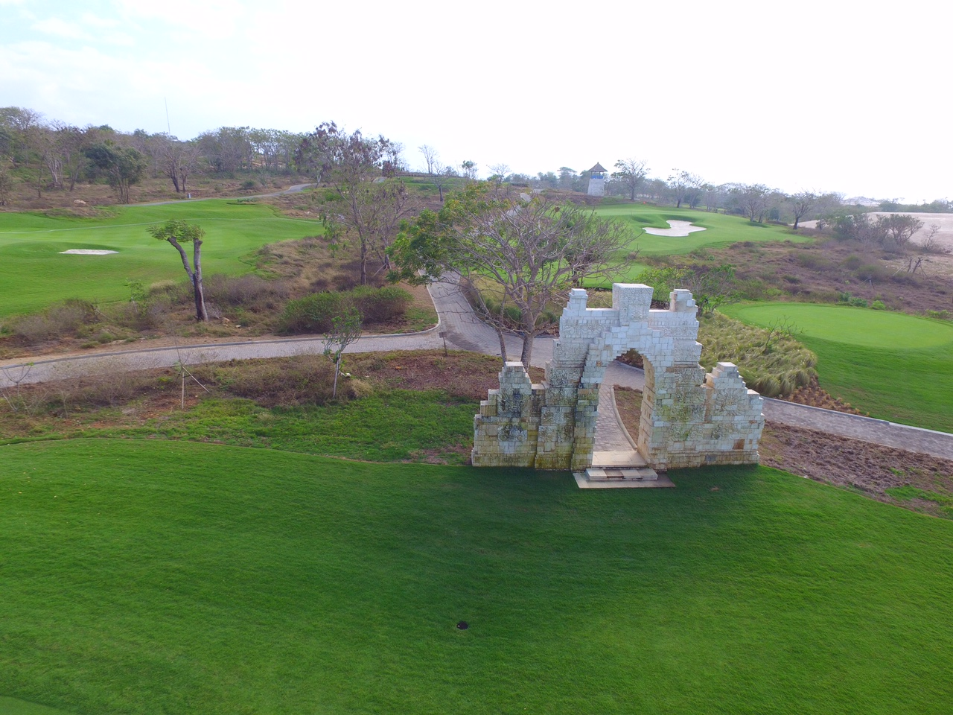

Slide 24
ADDITIONAL INFORMATION ON PURE DYNASTY SEEDED PASPALUM AND PLATINUM TE
Website: www.platinumte.com
~25 pdfs on general management guidelines
Herbicide information
Disease control information
Insect control information
GLOBAL MONITORING: rduncan4612@gmail.com

